Slide 1
Mr Brick Unplugged
Jakob Gottlieb Svendsen
Global Lead Developer / Principal consultant
CTGlobal A/S
Notes:
This is your opening. Now the stage is yours!

Slide 2
5
Video operator, did you start the recording?
Notes:
[REQUIRED SLIDE]
These slides are mandatory and help us with video post-processing. Please keep them as they are.

Slide 3
4
Notes:
[REQUIRED SLIDE]

Slide 4
3
Notes:
[REQUIRED SLIDE]

Slide 5
2
Notes:
[REQUIRED SLIDE]

Slide 6
1
Notes:
[REQUIRED SLIDE]

Slide 7
Mr Brick Unplugged
Jakob Gottlieb Svendsen
Global Lead Developer / Principal consultant
CTGlobal A/S
Notes:
This is your opening. Now the stage is yours!

Slide 8
How to insert your Twitter handle
1. On the Insert tab, select Header & Footer.
2. On the Slide tab, check the Footer box.
3. In the box below Footer, type your Twitter handle (e.g. @PSConfEU).
4. To prevent the footer from appearing on the title slide, check the Don't show on title slide box.
5. Click Apply to All button.

Slide 9
This Session
You will learn to like Mr Brick!
Though he can be kind of hard if you step on him!
Notes:
Please invest some time to reconsider your session: what is it that audience can get out of it? Try and be as precise as you can. If you are showing solutions, then focus on “how to”. If you present about a general technology, you’ll want to stick to “Be able to” or “Understand why/how”.

Slide 10
Agenda
Lego Self Service PSConfEU18
aka. What the brick happened last year?!?!
Admitting to failure
Moving on
Fixing last years troubles!
vNext!
Notes:
Psconf.eu is about demos and code. Try and minimize use of text slides

Slide 11
Mr. Brick Self Service - Steps
Order Robot Action
Await Email Approval
Trigger Mr. Brick
On-premises via WLAN
Notes:
Modules and Schedules are also Assets. OK :D

Slide 12
Mr. Brick Self Service
Portal
Share Point Online / On-premises
Engine
Azure Automation
Trigger Options
Microsoft Flow
Logical App
SharePoint Workflow via Webhook

Slide 13
Lego Self Service at PSConfEU18
Internet/WIFI via Smartphone
Portal: SharePoint
Trigger: Microsoft Flow
Engine: Azure Automation
Robot Moves! (Hopefully)
Notes:
Sum up your key messages

Slide 14
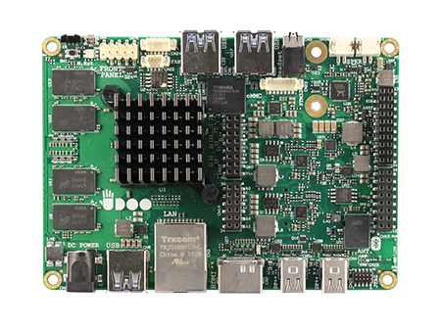
UDOO x86
X86 Maker board
Quad Core 64-bit Braswell 14nm
10x as fast as PI3.
Arduino 101 - Intel Curie
Runs 3 x 4k screens (1xHDMI 2xDP)
Running Windows 10 on M2 Disk
https://www.udoo.org/udoo-x86/

Slide 15
LEGO Self Service – Improved?!?

Slide 16
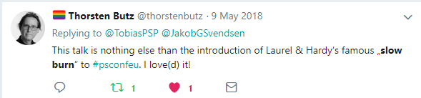

Slide 17
What the brick happened? – Part 1
WIFI via cellphone
Worked first ~10 times but not that day
CPU overload
Rusty voice + Voice control does not compute!
PSConfEU is way too fun!
And I speak too much
Notes:
Speak too much:
Wife not there

Slide 18
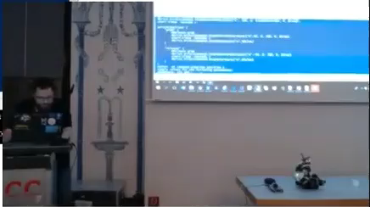

Slide 19
Can’t Go Straight? Drunk bot?!
Direct Commands in Series
Worked at home!
Doesn’t NOT work in busy WIFIs.
Use Batch commands!
I DO NOT MEAN .CMD FILES!
Notes:
Sum up your key messages

Slide 20
Dashing through the code
Batching all the way!

Slide 21
PSLegoEV3
Bot control module!
GitHub:
https://github.com/JakobGSvendsen/PSLegoEV3
PSCore/PS & PSWindows Version?!?!
Notes:
Notes:
Module?!?! Had none last year, felt small and outside the cool group!
Verbs! - Only Allowed verbs or nobody will even talk to you at the speaker hotel!
No Core = No Game!

Slide 22
Live Control with PSLegoEV3!
Notes:
PSReadLine

Slide 23
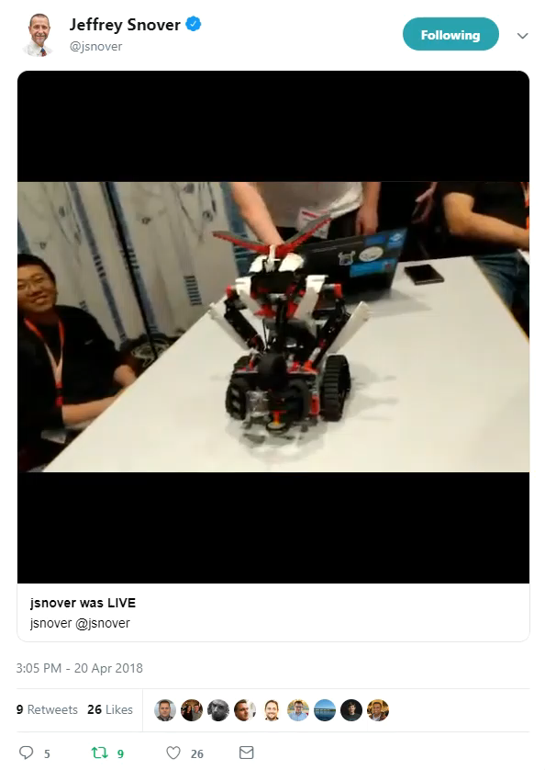
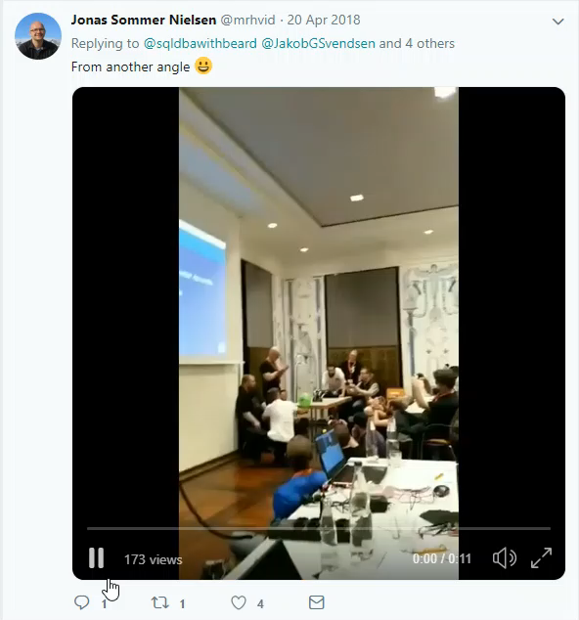
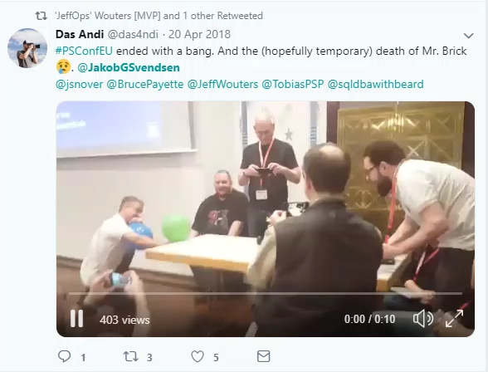
What the brick happened? – Part 2
Notes:
Sum up your key messages

Slide 24
Edge defence!
Notes:
PSReadLine

Slide 25
Color scanner?!
Notes:
PSReadLine

Slide 26
vNext
Can we avoid the on-prem machine??
Notes:
Speak too much:
Wife not there

Slide 27
Ev3dev
Debian Distro that run from SDCard.
www.ev3dev.org
Notes:
Speak too much:
Wife not there

Slide 28
# Follow these instructions to show perfectly color-coded PowerShell code.
# Paste code to PowerShell ISE, select it, and copy it to the clipboard.
Paste-Code -ToISE | Select-Code | Copy-ToClipboard
# To insert it with full color-coding, paste the code into your slide.
# It will be black, and there is a toolbutton labelled (Ctrl) in PPT.
Click-ToolButton -Choose SymbolWithClipboardAndBrush
# Click the toolbutton, and choose the button that shows a clipboard with a brush.
# This will add color-coding back to the pasted code
PLEASE NOTE: You do not need to use PowerShell ISE to code, or to demo.
Use your preferred editor. With a light theme.
These steps use PowerShell ISE to color-code your code correctly and consistently, and insert the color-coded code into the slide. Please help make all code look consistent. Many thanks!
This is an example of the “Code” layout.
Notes:
To color-code PowerShell code in a consistent way, we ask that you paste your code into PowerShell ISE, select it, and copy it from ISE. Next, paste the code into the text field. It will appear black at first. When you click the small tool button that appears after pasting the code, choose the middle icon with the brush. This adds back the token colors.
Again, use any editor you want during your demos. We ask that you use ISE solely for the purpose of consistently color-coding.
If you use editors other than ISE, make sure you choose a light theme. Dark themes are hard to watch in a presentation room.

Slide 29
Summary
Make sure you add a summary slide
Use 3-5 bullet points to reiterate key points
This is an example of the “Title and Content” layout.
Notes:
Sum up your key messages

Slide 30
about_Speaker
Jakob Gottlieb Svendsen
Global Lead Dev & Principal Consultant
CTGlobal A/S
https://ctglobalservices.com/
https://github.com/JakobGSvendsen/PSDJ
https://github.com/JakobGSvendsen/PSLegoEV3
Notes:
Do not EVER discuss this slide during your presentation. Please do not take presentation time to talk about yourself more than just a few introductory sentences. Instead, invite interested audience to the coffee break, and then talk about yourself, your job, your services, etc.
Use this slide to sum up your details. It will be part of the conference materials and recorded videos.

Slide 31
Notes:
[REQUIRED SLIDE]
Make sure you provide all materials that audience needs to reproduce your demos.
Either upload them as a PowerShell module to www.powershellgallery.com (preferred for reusable functions)
Or, upload them to our github repository (ask the girls at the info desk to provide you with access)
Or, upload them to your own github repository
Please make sure all materials are available by the time your presentation starts, or at minimum upload them right after your presentation

Slide 32
Notes:
[REQUIRED SLIDE]
If you sticked to your timing, you now have 15 min left for Q&A. If you missed your timing, you will have to leave the room when your slot is over. In this case, invite your audience to the coffee break and offer to cover questions there.
IN ANY CASE please point your audience to the conference app and the session voting. By the time the conference opens, the eventraft app *should* have the option to vote on sessions.
Please MAKE SURE you leave your room when your slot is over. The next speaker would like to set him/herself up and get everything up and running.

Slide 33
about_Speaker
Feel free to add information about yourself
You may advertise yourself or your company
Keep this slide at the end of your presentation
Do not use presentation time for your bio
Instead, your bio is published in the conference materials
Notes:
Do not EVER discuss this slide during your presentation. Please do not take presentation time to talk about yourself more than just a few introductory sentences. Instead, invite interested audience to the coffee break, and then talk about yourself, your job, your services, etc.
Use this slide to sum up your details. It will be part of the conference materials and recorded videos.

